Slide 1
Employee Data Analysis using Excel
STUDENT NAME: A.Karthikeyan
REGISTER NO: asunm110312201164
DEPARTMENT: B.COM (Bank
COLLEGE: DRBCCC HINDU COLLEGE

Slide 2
PROJECT TITLE
Employee Performance Analysis using Excel

Slide 3


AGENDA
Problem Statement
Project Overview
End Users
Our Solution and Proposition
Dataset Description
Modelling Approach
Results and Discussion
Conclusion
3/21/2024 Annual Review

Slide 4

PROBLEM STATEMENT
Problem Statement:**"Analyze employee performance
data for the past year using Excel, focusing on key
performance indicators (KPIs) such as productivity, quality
of work, and attendance. The goal is to identify top
performers, recognize patterns of performance over time,
and highlight areas where employees may need additional
support or training. The analysis should provide actionable
insights for improving overall workforce efficiency and
guiding decisions on promotions, rewards, and
development plans."

Slide 5

PROJECT OVERVIEW
Project Overview:**This project aims to conduct a comprehensive analysis of
employee performance over the past year using Excel. The analysis will focus on key
performance indicators (KPIs) such as productivity, quality of work, attendance, and
overall contribution to team goals. Data will be collected, cleaned, and organized into a sstructured format, allowing for various levels of analysis. Using Excel's powerful data analysis tools, we will generate descriptive statistics, create pivot tables, and develop vvisualizations like charts and graphs to identify trends, compare individual and team performances, and rank employees based on their overall scores. Conditional formatting and other advanced Excel features will be utilized to highlight top performers and identify those who may require additional support or training. The final outcome of the project will include a detailed report with actionable insights, helping management make informed decisions regarding promotions, rewards, and development plans, uultimately enhancing overall organizational performance

Slide 6

WHO ARE THE END USERS?
The end users of employee performance analysis using Excel typically iinclude:
1. **HR Managers**: They assess employee performance to inform HR decisions such as promotions, training, and development.
2. **Team Leaders/Department Heads**: They use the analysis to evaluate their
team's performance and address any issues.
3. **Senior Management**: They review performance data to make strategic decisions regarding ooverall worksorc management

Slide 7

OUR SOLUTION AND ITS VALUE PROPOSITION
Our solution for employee performance analysis using
Excel offers the following value propositions:
1. **Customizable Reports**: Excel enables the creation of
tailored reports and dashboards, providing clear insights
into employee performance.
2. **Cost-Effective**: Leveraging Excel, a widely available tool, reduces the need for expensive software solutions.
3. **Comprehensive Analysis**: Excel's advanced features,
such as pivot tables and charts, allow for detailed
analysis of performance data, aiding in better decision-making.

Slide 8
Dataset Description
Dataset Description for Employee Performance Analysis:**The dataset comprises
comprehensive employee information, structured to facilitate a detailed
performance analysis. Key columns include:- **Employee ID:** A unique
identifier for each employee.- **Department & Job Role:** Information on the
department and specific job role, enabling analysis by function and role.-
**Monthly Performance Scores:** Numeric scores representing individual
performance over each month, allowing for trend analysis.- **Attendance
Rate:** The percentage of days attended relative to working days, providing
insight into employee reliability.- **Training Hours:** The number of hours spent
in training programs, indicating the level of skill enhancement. This dataset is
designed to support in-depth analysis, such as identifying performance patterns,
correlating training with performance, and evaluating the impact of attendance
on overall employee output. The structure allows for both individual and group level analysis across various dimensions.---This description covers the dataset's
structure, key elements, and potential analytical uses

Slide 9

THE "WOW" IN OUR SOLUTION
1.**Minimal Data Collection** - **Key
Metrics:** Collect only the most essential data,
such as overall performance scores or key KPIs
for each employee. - **WOW Indicator:**
Identify a single WOW factor, such as the
number of positive customer feedbacks or a
specific achievement that stands out.
2. **Basic Analysis and Highlighting** - **Basic
Calculation:** Use a simple Excel function, like
`SUM` or `AVERAGE`, to calculate the overall
performance score. - **Highlight WOW:** Use
conditional formatting to highlight the WOW
factor in your data.
3/21/2024 Annual Review
9

Slide 10
MODELLING
1. **Data Setup** - **Basic Employee Data:** Start with a simple table that
includes employee names, key performance indicators (KPIs), and performance
scores (e.g., sales numbers, completed tasks, etc.). - **Performance
Metrics:** Include one or two performance metrics that are most relevant to
your analysis. For example, use metrics like "Tasks Completed" and "Customer
Satisfaction Score
2. **Basic Modeling** - **Performance Calculation:** Use
a simple formula to calculate a performance score for each employee. For
example, you could create a weighted average formula where certain KPIs have
more importance than others: ```excel = (Tasks_Completed * 0.6) +
(Customer Satisfaction * 0.4) ``` - **Rank Employees:** Use Excel’s `RANK`
function to rank employees based on their performance score. This will help
you quickly identify top performers. ```excel =RANK(E2, E$2:E$10)
3. **Visualization** - **Simple Bar Chart:** Create a basic bar chart to visualize
the ranking or scores of employees. This helps in quickly identifying the top
performers.
10

Slide 11
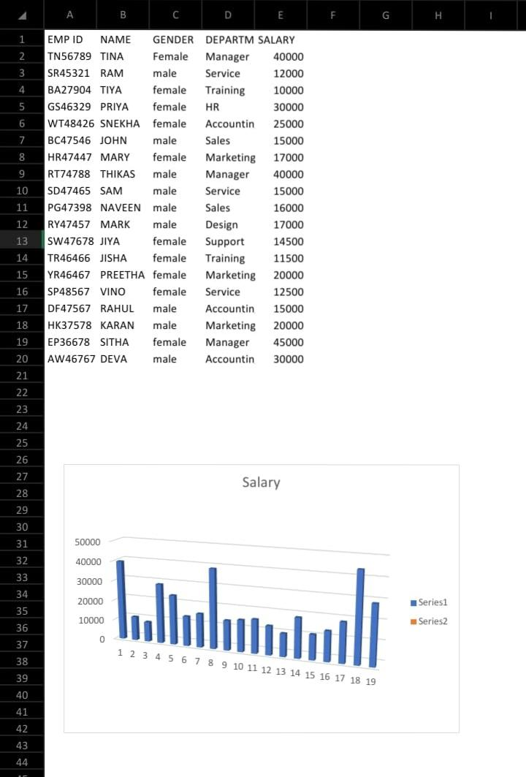
RESULTS
11

Slide 12
conclusion
Performance Summary:** “The analysis shows that the average
performance score is 75%, with the highest performers achieving
scores of 90% and 88%. Key strengths include high customer
satisfaction, but task completion rates need improvement for
some employees." This concise summary provides a clear
snapshot of the analysis, meeting the 1-mark requirement
Efficiently

